Slide 1
UPPER SIXTH ARTS
GEOGRAPHY
Field Work 1
Getting Geographical Coordinates
Notes:
Good morning, class, and welcome to our geography lesson. I am your geography teacher, Mr Kamdem. Today we are starting Field Work 1: Getting Geographical Coordinates.

Slide 2
CLASS INFO
Class, Chapter and Duration
Class | Upper Sixth Arts
Chapter | Module 8: Understanding and carrying out statistical techniques, topographic map analysis, fieldwork and project based learning
Duration | 2 periods (2 × 50 minutes)
Notes:
This lesson is for Upper Sixth Arts. It belongs to Module 8: Understanding and carrying out statistical techniques, topographic map analysis, fieldwork and project based learning. We shall need 2 periods to cover it.

Slide 3
IDENTIFICATION
Lesson Identification
Topic | Fieldwork in Geography
Sub-topic | Location in Geography
Lesson | Field Work 1: Getting Geographical Coordinates
Notions / Concepts | Direction, bearing, compass, GPS, latitude, longitude.
Syllabus focus | Directions and bearings; the compass (meaning and uses, outdoor demonstration); the GPS (meaning and uses, outdoor demonstration with a phone).
Competence | Learners are able to find directions and bearings and obtain coordinates with a compass and a GPS.
Notes:
Our topic is Fieldwork in Geography, and the sub-topic is Location in Geography. The key notions we shall use today are: direction, bearing, compass, GPS, latitude, longitude. At the end, you should be able to do this: learners are able to find directions and bearings and obtain coordinates with a compass and a GPS.

Slide 4

HOMEWORK CORRECTION
Correction of the Homework
Question (Quantitative Techniques 4: Plotting and Interpreting Graphical Tools):
Name the instrument that gives geographical coordinates by satellite.
Notes:
Before we start the new lesson, let us correct the homework I gave you at the end of Quantitative Techniques 4: Plotting and Interpreting Graphical Tools. The question was: Name the instrument that gives geographical coordinates by satellite. Take out your exercise books.

Slide 5
HOMEWORK CORRECTION
Correction: Possible Answer
The GPS (Global Positioning System) receiver.
Notes:
Here is a good answer. The GPS (Global Positioning System) receiver. Compare it with your own answer and correct your work in red.

Slide 6
LESSON PLAN
Lesson Plan
Correction of the homework
Objectives and recall
Real-life situation and action to take
Learning activities
Board summary
Evaluation, remediation and homework
Notes:
Here is the plan of our lesson today. First, we shall correct the homework. Then we shall look at the objectives and recall what you already know. After that, we shall study a situation from real life and the action to take, and do the learning activities. Finally, we shall copy the board summary, do the evaluation and the remediation, and I will give you the homework.

Slide 7
OBJECTIVES
Objectives
By the end of this lesson, you should be able to:
Give directions and measure bearings.
Use a compass in the field.
Obtain coordinates with a GPS or smartphone.
Notes:
By the end of this lesson, you should be able to do three things. Number 1: give directions and measure bearings. Number 2: use a compass in the field. Number 3: obtain coordinates with a GPS or smartphone.

Slide 8
PREVIOUS KNOWLEDGE
Previous Knowledge
The four cardinal points are N, E, S and W.
Latitude and longitude locate places.
Notes:
Let us first remember what you already know. The four cardinal points are N, E, S and W. Latitude and longitude locate places. Keep this in mind, because we shall build on it today.

Slide 9
REAL-LIFE SITUATION
Situation in Real Life
The class goes to the school field. The teacher asks each group to find the bearing of the market from the school gate and the latitude and longitude of the gate with a phone.
Notes:
Listen carefully to this situation from real life. The class goes to the school field. The teacher asks each group to find the bearing of the market from the school gate and the latitude and longitude of the gate with a phone. Think about it, because I am going to ask you some questions.

Slide 10
REAL-LIFE SITUATION
Situation: Question 1
What is the problem in the situation?
Notes:
Question 1: What is the problem in the situation? Think for a moment, then raise your hand to answer.

Slide 11
REAL-LIFE SITUATION
Answer
The class must locate places in the field.
Notes:
Good. The class must locate places in the field.

Slide 12
REAL-LIFE SITUATION
Situation: Question 2
Which tool measures bearings?
Notes:
Question 2: Which tool measures bearings? Think for a moment, then raise your hand to answer.

Slide 13
REAL-LIFE SITUATION
Answer
A compass.
Notes:
Good. A compass.

Slide 14
REAL-LIFE SITUATION
Situation: Question 3
Which tool gives latitude and longitude?
Notes:
Question 3: Which tool gives latitude and longitude? Think for a moment, then raise your hand to answer.

Slide 15
REAL-LIFE SITUATION
Possible Answer
A GPS (or smartphone).
Notes:
Good. A GPS (or smartphone).

Slide 16
ACTION TO TAKE
Action to Take
Locate places precisely with a compass or a phone GPS.
Notes:
From this situation, the action we are working towards in this lesson is the following: locate places precisely with a compass or a phone GPS.

Slide 17
JUSTIFICATION
Justification of the Lesson
This fieldwork teaches us to locate places precisely.
Notes:
Why is this lesson important for you? This fieldwork teaches us to locate places precisely.

Slide 18
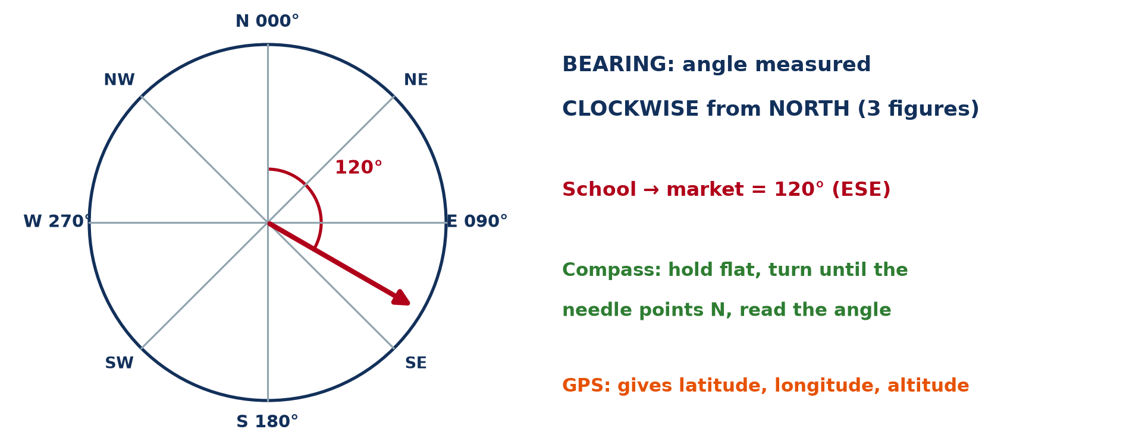
1. DIRECTIONS AND BEARINGS
Activity 1
Bearings.
Notes:
Activity 1. Look carefully at this diagram: bearings. Observe every detail before I ask the question.

Slide 19
1. DIRECTIONS AND BEARINGS
Activity 1: Question
What is a bearing, and what is the bearing of south-west?
Notes:
Here is the question for Activity 1: What is a bearing, and what is the bearing of south-west? Take one minute to think and write your answer in your rough notebook.

Slide 20
1. DIRECTIONS AND BEARINGS
Activity 1: Answer
An angle measured clockwise from north; south-west is 225°.
Notes:
Let us check the answer together. An angle measured clockwise from north; south-west is 225°.

Slide 21
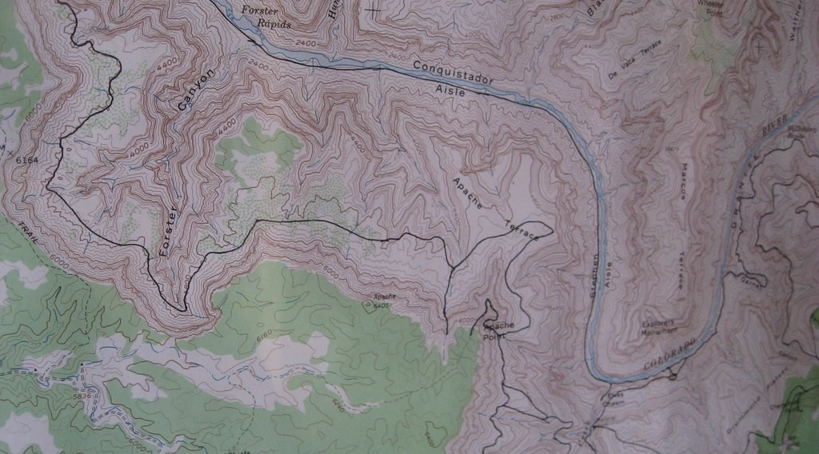
2. MAP AND COMPASS
Activity 2
A topographic map used in the field.
Notes:
Activity 2. Look carefully at this picture: a topographic map used in the field. Observe every detail before I ask the question.

Slide 22
2. MAP AND COMPASS
Activity 2: Question
Why do you orient the map with a compass in the field?
Notes:
Here is the question for Activity 2: Why do you orient the map with a compass in the field? Take one minute to think and write your answer in your rough notebook.

Slide 23
2. MAP AND COMPASS
Activity 2: Answer
So that directions on the map match directions on the ground.
Notes:
Let us check the answer together. So that directions on the map match directions on the ground.

Slide 24
2. BACK BEARING
Activity 3
Bearing school → market = 120°.
Notes:
Activity 3. Look carefully at this diagram: bearing school → market = 120°. Observe every detail before I ask the question.

Slide 25
2. BACK BEARING
Activity 3: Question
Find the bearing from the market back to the school.
Notes:
Here is the question for Activity 3: Find the bearing from the market back to the school. Take one minute to think and write your answer in your rough notebook.

Slide 26
2. BACK BEARING
Activity 3: Answer
120° + 180° = 300°.
Notes:
Let us check the answer together. 120° + 180° = 300°.

Slide 27
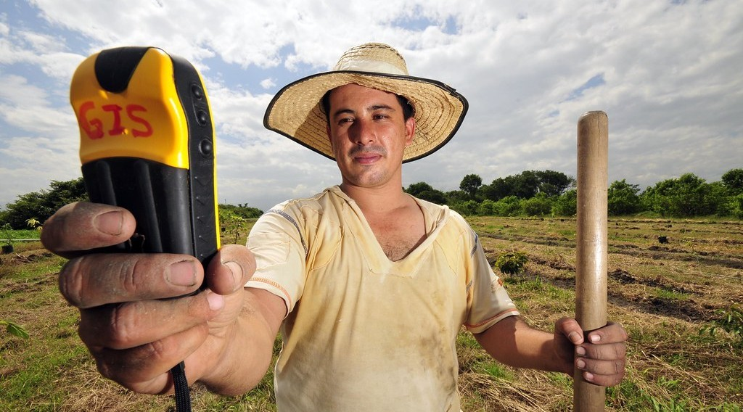
3. THE GPS
Activity 4
A GPS receiver.
Notes:
Activity 4. Look carefully at this picture: a GPS receiver. Observe every detail before I ask the question.

Slide 28
3. THE GPS
Activity 4: Question
What information does a GPS give?
Notes:
Here is the question for Activity 4: What information does a GPS give? Take one minute to think and write your answer in your rough notebook.

Slide 29
3. THE GPS
Activity 4: Answer
Latitude, longitude and altitude (also time and speed).
Notes:
Let us check the answer together. Latitude, longitude and altitude (also time and speed).

Slide 30

3. FIELD DEMONSTRATION
Activity 5
Steps of fieldwork.
Notes:
Activity 5. Look carefully at this diagram: steps of fieldwork. Observe every detail before I ask the question.

Slide 31
3. FIELD DEMONSTRATION
Activity 5: Question
Give two safety rules for fieldwork.
Notes:
Here is the question for Activity 5: Give two safety rules for fieldwork. Take one minute to think and write your answer in your rough notebook.

Slide 32
3. FIELD DEMONSTRATION
Activity 5: Answer
Stay in groups and follow the teacher's instructions (also avoid roads and rivers).
Notes:
Let us check the answer together. Stay in groups and follow the teacher's instructions (also avoid roads and rivers).

Slide 33
BOARD SUMMARY
Board Summary
Topic: Fieldwork in Geography
Sub-topic: Location in Geography
Field Work 1: Getting Geographical Coordinates
Notes:
Now we are going to copy the board summary. Write the title and the headings neatly in your notebooks. I will give you enough time for each slide, so do not rush.

Slide 34
BOARD SUMMARY
1. Directions and Bearings
Directions are given in two ways:
Directions: The 16 points of the compass (N, NNE, NE…) describe direction in words. They are less precise than bearings.
Bearing: It is an angle measured clockwise from north, from 000° to 360°. The back bearing is the bearing ± 180°.
Notes:
Let us copy Directions and Bearings. Directions are given in two ways. On this slide we have Directions and Bearing. Write each point on a new line, with the key term first, and explain it in your own words when we revise.

Slide 35
BOARD SUMMARY
1. Directions and Bearings
Illustration: bearings
Notes:
Now draw this illustration in your notebook: bearings. Give it a title and label it clearly.

Slide 36
BOARD SUMMARY
2. The Compass
The compass is used as follows:
Meaning and uses: A compass has a magnetic needle that points to magnetic north. It is used to find directions and to orient maps in the field.
Notes:
Let us copy The Compass. The compass is used as follows. On this slide we have Meaning and uses. Write each point on a new line, with the key term first, and explain it in your own words when we revise. When you finish, we go to the next slide.

Slide 37
BOARD SUMMARY
2. The Compass (continued)
Outdoor demonstration: Hold the compass flat, point the arrow at the target and turn the dial until the needle sits on N. Read the bearing on the dial.
Notes:
We continue with The Compass. On this slide we have Outdoor demonstration. Write each point on a new line, with the key term first, and explain it in your own words when we revise.

Slide 38
BOARD SUMMARY
3. The GPS
The GPS is used as follows:
Meaning and uses: The Global Positioning System uses satellites to give latitude, longitude and altitude. It is used in navigation, mapping and fieldwork.
Notes:
Let us copy The GPS. The GPS is used as follows. On this slide we have Meaning and uses. Write each point on a new line, with the key term first, and explain it in your own words when we revise. When you finish, we go to the next slide.

Slide 39
BOARD SUMMARY
3. The GPS (continued)
Outdoor demonstration: Open a map or GPS app on a phone and wait for a good signal. Record the coordinates of each place and plot them on a sketch.
Notes:
We continue with The GPS. On this slide we have Outdoor demonstration. Write each point on a new line, with the key term first, and explain it in your own words when we revise.

Slide 40
BOARD SUMMARY
3. The GPS
Illustration: steps of fieldwork
Notes:
Now draw this illustration in your notebook: steps of fieldwork. Give it a title and label it clearly.

Slide 41
FORMATIVE EVALUATION
Evaluation 1
Give the bearings of east and north-west.
Notes:
Now let us check what you have understood. Question 1: Give the bearings of east and north-west. Answer in your exercise book.

Slide 42
FORMATIVE EVALUATION
Expected Answer
090° and 315°.
Notes:
The expected answer is: 090° and 315°. If you got it right, well done.

Slide 43
FORMATIVE EVALUATION
Evaluation 2
Give two uses of a GPS in fieldwork.
Notes:
Now let us check what you have understood. Question 2: Give two uses of a GPS in fieldwork. Answer in your exercise book.

Slide 44
FORMATIVE EVALUATION
Expected Answer
Recording sample sites and mapping routes.
Notes:
The expected answer is: recording sample sites and mapping routes. If you got it right, well done.

Slide 45
REMEDIATION
Remediation
Fill in the blanks:
Bearings are measured ______ from north.
The bearing of south is ______.
Back bearing = bearing ± ______.
Notes:
For those who need more practice, fill in the blanks in your exercise book. The answers are: number 1, clockwise; number 2, 180°; number 3, 180°.

Slide 46
HOMEWORK
Homework
Record the coordinates of five places in your neighbourhood with a phone and plot them on a sketch.
Notes:
For your homework: Record the coordinates of five places in your neighbourhood with a phone and plot them on a sketch. We shall correct it at the beginning of our next lesson.

Slide 47
NEXT LESSON
Next Lesson
Our next lesson will be on:
Field Work 3: Fieldwork in Hydrology: Running Water
Notes:
Our next lesson will be on Field Work 3: Fieldwork in Hydrology: Running Water. Thank you for your attention, and see you next time.

Slide 48
BILINGUAL GAME
Bilingual Game (Jeu Bilingue)
English | Français
Compass | La boussole
Bearing | L'azimut
North | Le nord
Latitude | La latitude
Longitude | La longitude
GPS | Le GPS
Notes:
Let us play the bilingual game. I say a word in English, and you give me the French word. Then we do the reverse.

Slide 49
LOGBOOK
Official Logbook (1/2)
Module / Topic | Fieldwork in Geography
Lesson Title | Field Work 1: Getting Geographical Coordinates
Expected Learning Outcomes | Give directions and measure bearings. Use a compass in the field. Obtain coordinates with a GPS or smartphone.
Competence | Learners are able to find directions and bearings and obtain coordinates with a compass and a GPS.
Notes:
I record this information in the official logbook of the class after the lesson.

Slide 50
LOGBOOK
Official Logbook (2/2)
Matter Taught | Directions and Bearings; The Compass; The GPS.
Evaluation | Formative evaluation and remediation exercise.
Homework | Record the coordinates of five places in your neighbourhood with a phone and plot them on a sketch.
Enrolment / Present / Absent | ____ / ____ / ____
Achievement | To be completed after the lesson.
Notes:
I complete the second page of the logbook: the matter taught, the evaluation, the homework and the attendance.

Slide 51
TEACHER'S NOTE
Teacher's Note
Timing: Homework correction, plan, objectives 8 min | Recall, situation, action 10 min | 5 activities 30 min | Board summary (copying) 30 min | Evaluation, remediation 10 min | Homework, next lesson 5 min | Logbook 7 min
Without the projector (Activity 1): give bearings.
Without the projector (Activity 2): orient a map outside.
Without the projector (Activity 3): calculate back bearings.
Without the projector (Activity 4): use a phone app.
Without the projector (Activity 5): plan the outing.
Notes:
This slide is for me, the teacher: it gives the timing of the lesson and what to do if the projector is not available.

Slide 52
REFERENCES
References
National Geography Syllabus, MINESEC/IGE/IP-SS, 2019 — Module 8 (Practical Geography).
Photo, Activity 2: “Harvey Butchart's hiking map” by brewbooks, CC BY-SA 2.0, via Flickr (https://www.flickr.com/photos/93452909@N00/5289678354)
Photo, Activity 4: “DAPA GPS Fruit 5” by CIAT International Center for Tropical Agriculture, CC BY-SA 2.0, via Flickr (https://www.flickr.com/photos/38476503@N08/4821530518)
Diagrams and animations: drawn for this lesson (Geography Department).
Notes:
These are the references and picture credits used to prepare this lesson.

